Slide 1
Maximizing Curriculum Mapping with Library Resources
by
Jason Phillips, Social Sciences Librarian
&
Andrew Todd, College of Nursing Librarian

Slide 2
Overview
Introductions
Library Reviews
Curriculum Mapping
Benefits of Course-Related Curriculum Mapping
Course Designation Incentives
Potential Library Activities & Applications
Curriculum Mapping Examples
Resources
Activity

Slide 3
Introducing Jason Phillips
Social Sciences Librarian
Liaison to Criminal Justice & Sociology
Program Reviews
Started January 2022
16 years of experience
University of Alabama
Mississippi State University
Georgetown University
University of Arkansas – Fort Smith
About Me
Native of Pensacola / Mobile
Graduate from University of Alabama
BA in History & Political Science
MA in History
Master’s in Library & Information Studies
Reference, Instruction, & Research Consultations

Slide 4
Introducing Andrew Todd
Subject Librarian for Nursing
Regional/Connect Campus Librarian
Reference, Instruction, & Research Consultations
Embedded Librarian
BSN, UCF
MLIS, USF

Slide 5
Introduction
This session will focus on curriculum mapping from a library perspective and highlights several practical applications in course development.
How to integrate library resources to support textbook affordability and learning outcomes:
Strategies to ensure that students obtain skills necessary to leverage library databases;
Courses to target in order to ensure teaching research through course assignments.
Topics will include:

Slide 6
Curriculum Mapping from Champlain College

Slide 7
Library Reviews
Library Reviews
7-Year Program Reviews
Accreditation Visits
New programs, degrees, certificates
Review Process – Faculty/Department
List of keywords / subject headings
List of peer institutions
Curriculum description

Slide 8
Library Reviews
Keywords / Subject Headings
Peer list
Accrediting agencies
U.S. News & World Report
Environmental scan of collections
Books / eBooks - Catalog
Journals – Journal Citation Reports, Scimago
Databases & Research Guides
Compare collections to peers
Catalog – Books, Journals
Databases lists, Research Guides

Slide 9
Book/eBook Analysis

Slide 10
Journal Analysis

Slide 11
Database Analysis

Slide 12
Curriculum Mapping
Reviews course descriptions
Look for keywords
Common terms from different courses?
Ideal: Obtain syllabi and course assignments
Learn course needs and learning outcomes
Research-intensive course? Foundational course?
High impact
Target these courses for library services

Slide 13
Curriculum Mapping
Curriculum Mapping and the Review Process:
Identify Strengths in the collection
Identify Gaps in the collection
Highlight existing resources
Outcome:
List of books, journals, and databases
Identify high-impact courses to target
Scaffold learning outcomes to course levels

Slide 14
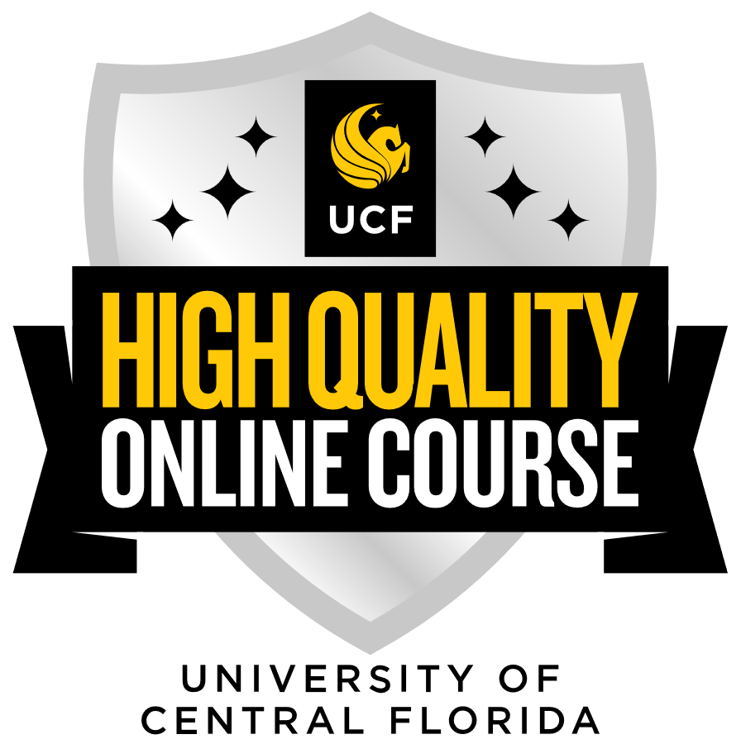
Course Designation Incentives
Quality Online Course/High Quality Online Course https://cdl.ucf.edu/services/instructional/ucf-quality-initiative/
Research Intensive https://academicsuccess.ucf.edu/our/faculty/research-intensive-courses/

Slide 15
Potential Library Activities and Applications
Embedded librarians
Search Strategy Activities
Citation style and plagiarism guidance
Textbook affordability
Instruments
& Tools

Slide 16
Graduate Curriculum Mapping example
College of Nursing DNP Program
NGR 7855c
NGR 7911c
NGR 7912
NGR 7913
Common eBooks
Bonnel, W., & Smith, K. V. (2017). Proposal writing for clinical nursing and DNP projects (2nd ed.). Springer.
Dang, D., Dearhold, S. L., Bissett, K., Ascenzi, J., & Whalen, M. (2022). Johns Hopkins evidence-based practice for nurses and healthcare professionals (4th ed.). Sigma Theta Tau International. Reavy, K. (2016). Inquiry and leadership: A resource for the DNP project. F.A. Davis.
Sylvia, M. L., & Tehhaar, M. F. (2018). Clinical analytics and data management for the DNP (2nd ed.). Springer.
Bauce, K., & Fitzgerald, J. J. (Eds.) (2018). Nursing research critiques: A model for excellence. Springer. Bradshaw, M. J., & Bitale, T. R., (2021). DNP project workbook: A step-by-step process for success. Springer.
Jolley, J., (2020). Introducing research and evidence-based practice for nursing and healthcare professionals (3rd ed.). Routledge.
Smith, M. J., & Liehr, P. R. (Eds). (2018). Middle range theory for nursing (4th ed.). Springer.

Slide 17
Undergraduate Curriculum Mapping examples
NGR 3616
NGR 3165
NGR 4637
NGR 3805

Slide 18
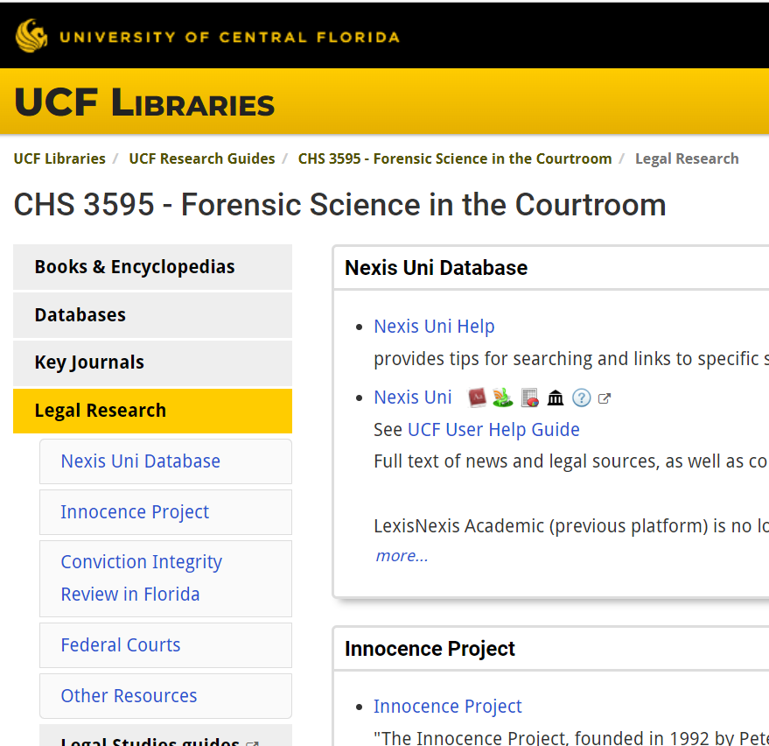
Resources
Subject/Connect Librarians
https://library.ucf.edu/subject/All/
Research Guides
https://guides.ucf.edu/homepage
Course Guides:
https://guides.ucf.edu/course1
Can be embedded in Canvas!

Slide 19
Activity
Form into groups
Discuss and identify:
Library activity used in a class
One library related skill you would like to see addressed in your curriculum
Did Covid change the activity?

