Slide 1
Textbook Affordability + WordPress + DC API = Unique eTextbook Portal Collaboration
Lee Dotson
Bobby Ciullo
Lily Dubach
Kerri Bottorff
Notes:
Please put questions in Q&A/chat so we can follow up with you as time allows

Slide 2
Collaborative Team
Lee Dotson
Institutional Repository
Bobby Ciullo
Web Services
Lily Dubach
Textbook Affordability
Kerri Bottorff
Institutional Repository
Notes:
Lee – 30 seconds (1 slide)

Slide 3
Textbook Affordability
AFFORDABLE INSTRUCTIONAL MATERIALS INITIATIVE UCF Libraries, Division of Digital Learning, Faculty Center for Teaching and Learning, UCF Bookstore, and Office of the Provost and Academic Affairs. https://provost.ucf.edu/initiatives/affordability/
UCF LIBRARIES
Sourcing library eBooks (eTextbooks).
Finding OER (Open Educational Resources).
Tracking savings metrics.
https://library.ucf.edu/textbook-affordability
Notes:
Lily – 1 minute
UCF collaborates across departments with the Affordable Instructional Materials Initiative recognized by the Provost's Office. The library sources eBooks (or eTextbooks) that match course required textbooks. We also collaborate with instructional designers to help faculty find or create open educational resources to use instead of traditional textbooks. We track and calculate potential savings from our library eBooks and OER, and as of this summer reached approximately $10.9 million dollars in potential savings since 2016.

Slide 4
eTextbook Portal
INSPIRED BY Louisiana State University & Florida State University.
WHAT IS IT? Students can search for library eTextbooks similar to the bookstore's textbook search. This helps inform students beyond what is already in place (bookstore note and faculty's syllabus statements).
WHY NOT PRIMO'S COURSE RESERVES? Upload types, information included, display options.
Notes:
Lily – 1 minute
How do students know about library eTextbooks that match course required textbooks? We were inspired by the eTextbook portals created by Louisiana State University and Florida State University. These portals allow students to search for library eTextbooks using course information. Without this portal, students relied on faculty including a note for the bookstore's textbook display and information in the class syllabus, both of which may not always happen. We didn't need to make a new eTextbook Portal system since we have Primo's Course Reserves, but we wanted additional ways to upload content, different fields of information, and more display options that you will see soon.

Slide 5
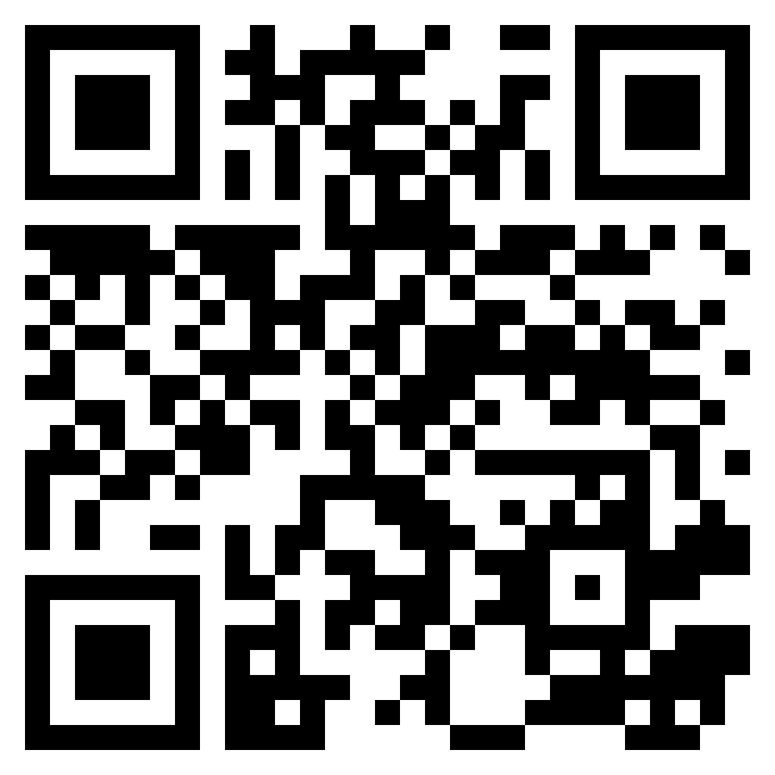
Using STARS/Digital Commons
BOOK GALLERY
Store data for eTextbook Portal webpage
Ease of uploading and updating book information
Provide cover image thumbnails
Allow administrator privileges
https://stars.library.ucf.edu/etextbooks/
Notes:
Lee – 2 minutes (3 slides total: 1/3)

Slide 6
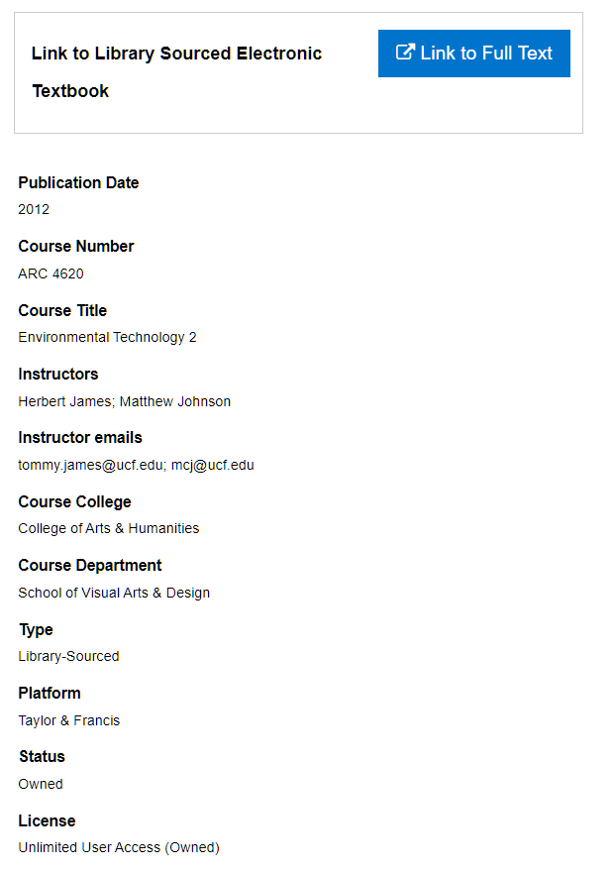
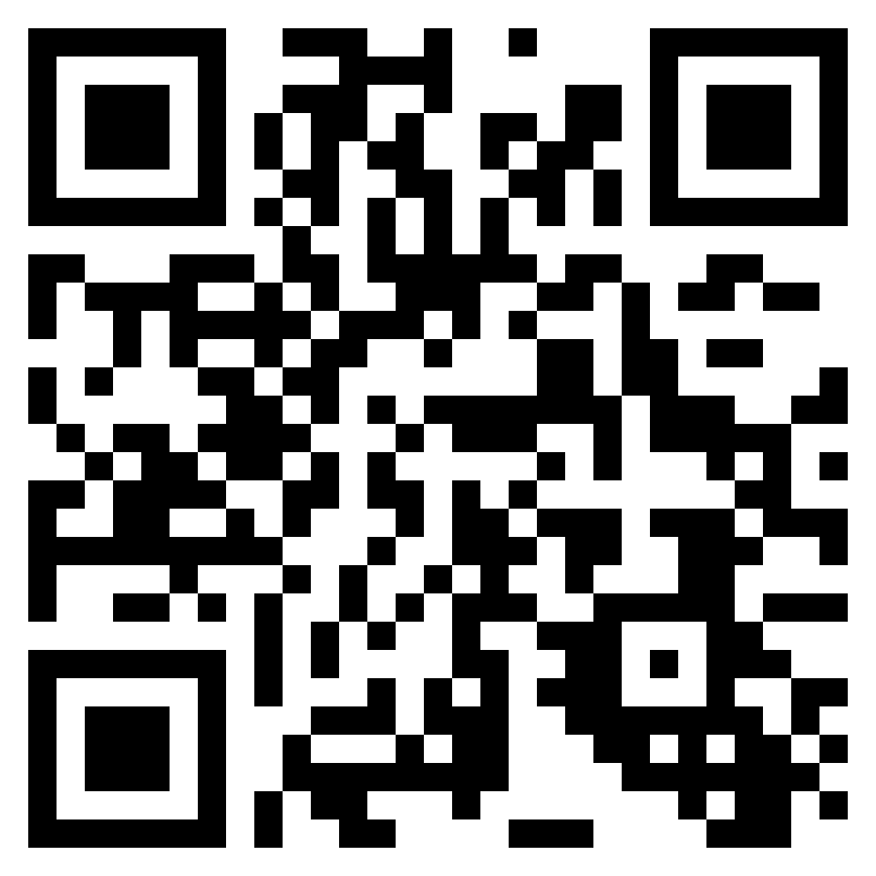
Using STARS/Digital Commons
CUSTOM FIELDS
Tailor fields for use in the eTextbook Portal
Reserve fields for administrative purposes
Expose metadata via the DC API
https://stars.library.ucf.edu/etextbooks/1/
Notes:
Lee – 2 minutes continued (3 slides total: 2/3)

Slide 7
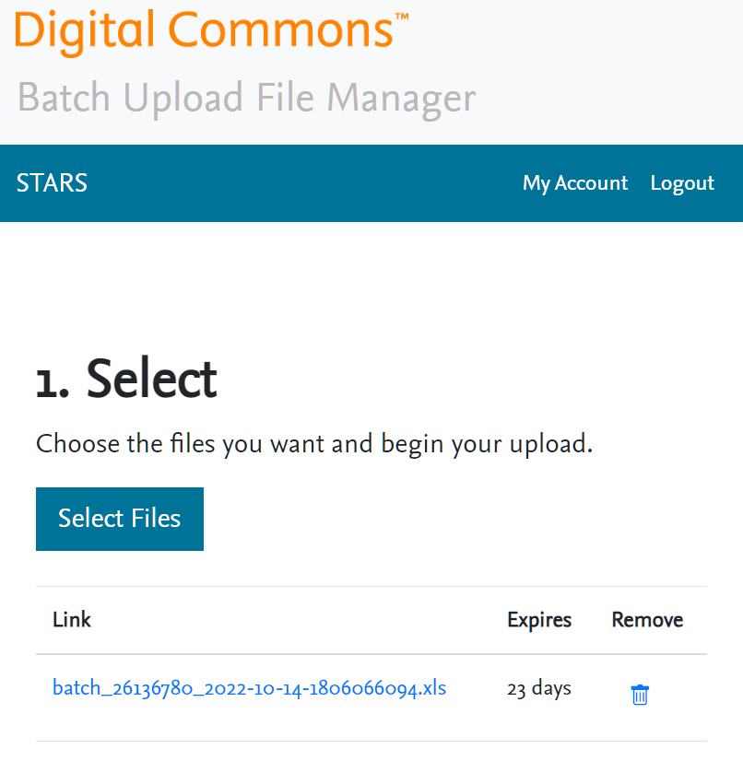
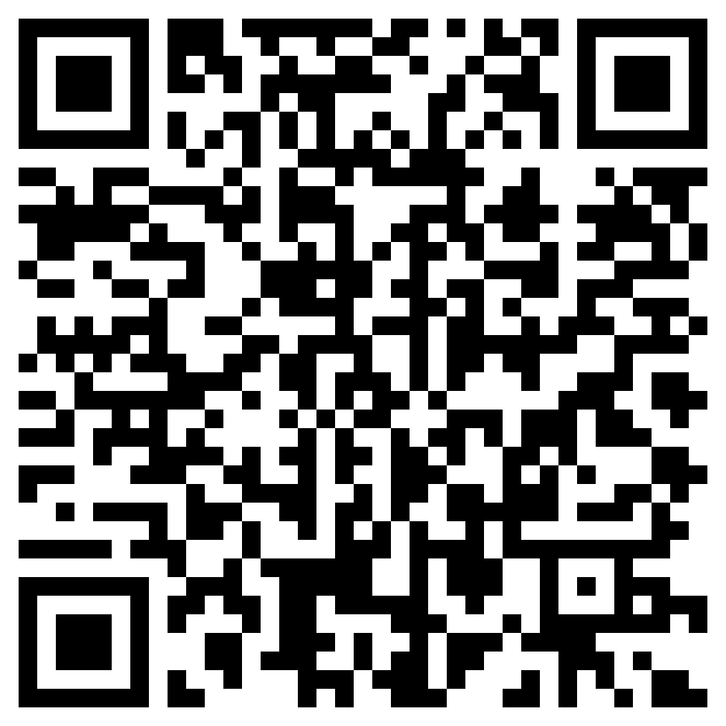
Using STARS/Digital Commons
BATCH UPLOAD FILE MANAGER
Complements the existing Batch Upload tool by allowing upload of full-text and other files from your local computer, eliminating the need for unsecured servers or 3rd party file storage
Create links for provided book cover images
Ease of use – not just for IR managers
https://bepress.com/wp-content/uploads/2017/01/Digital-Commons-Batch-Upload-File-Manager-guide.pdf
Notes:
Kerri – 2 minutes continued (3 slides total: 3/3)
For the cover image thumbnails

Slide 8
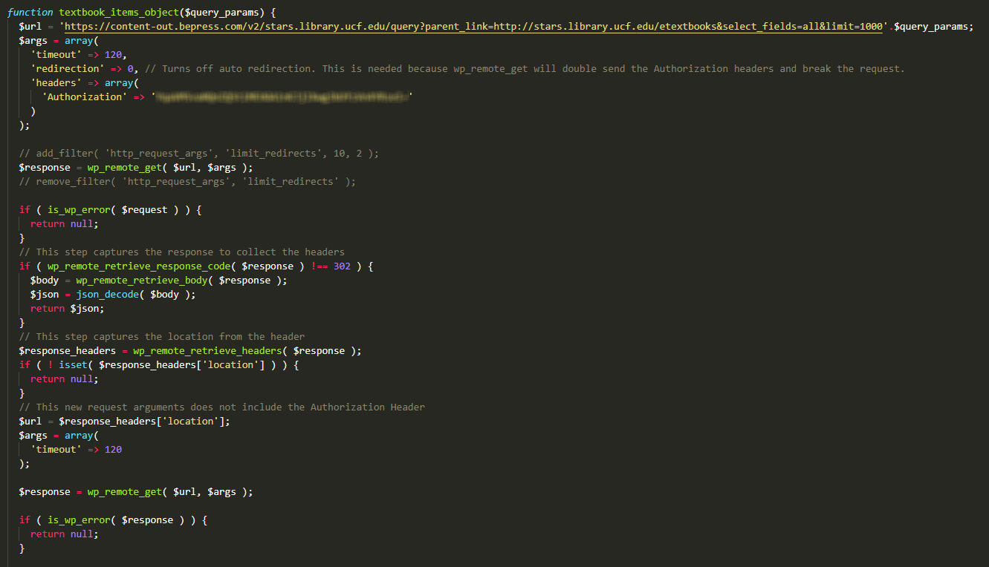
WordPress and the DC API
Getting the DC API to work with WordPress
What’s missing from the API for the eTextbook Portal?
Notes:
Bobby – 2 minutes
Missing?
Sort – solved on website side
Book cover images – created a metadata field to copy the link into

Slide 9
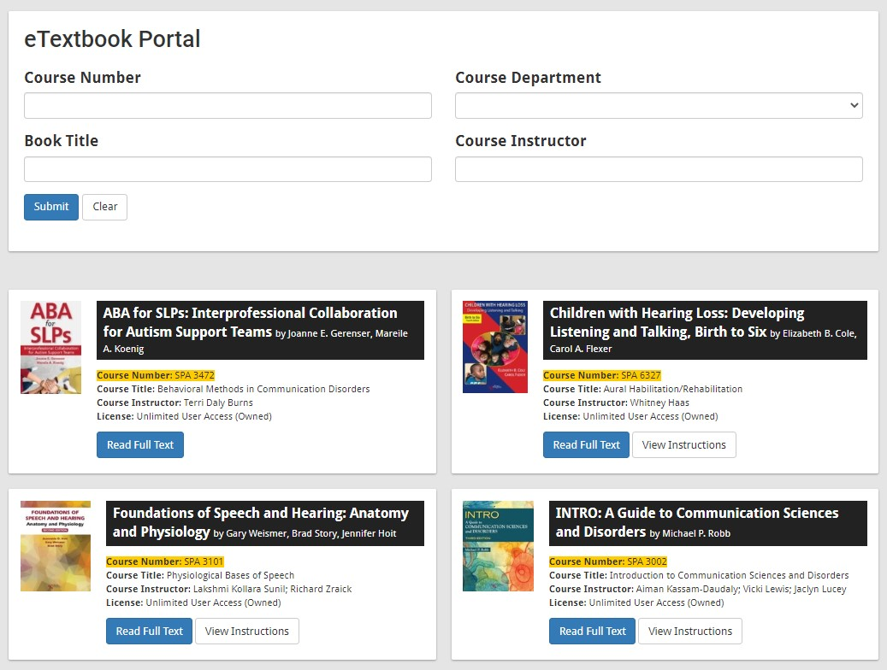
eTextbook Portal in Action
The eTextbook Portal helps students locate library eTextbooks and Open Educational Resources (OER) used for courses.
https://library.ucf.edu/etextbooks/
Notes:
Lily – 2 minutes

Slide 10
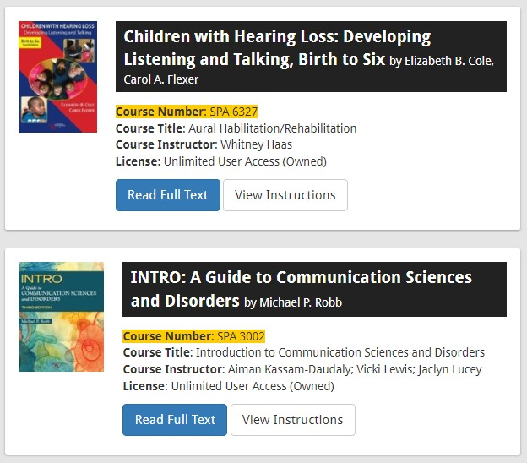
eTextbook Portal in Action
The eTextbook Portal helps students locate library eTextbooks and Open Educational Resources (OER) used for courses.
https://library.ucf.edu/etextbooks/
Notes:
Lily – 2 minutes continued

Slide 11
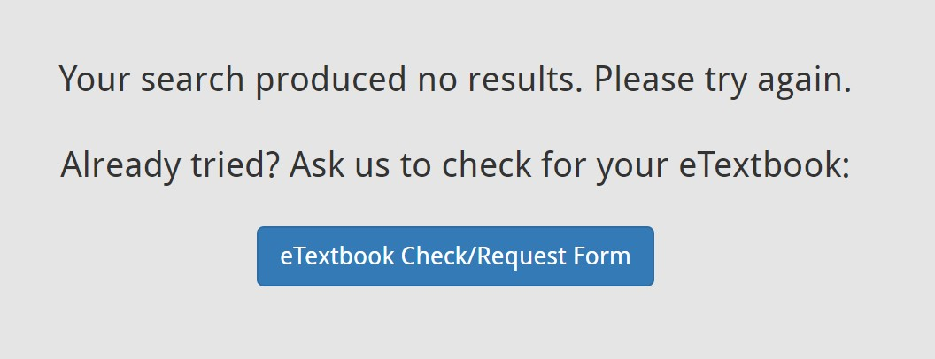
eTextbook Portal in Action
The eTextbook Portal helps students locate library eTextbooks and Open Educational Resources (OER) used for courses.
https://library.ucf.edu/etextbooks/
Notes:
Lily – 2 minutes continued

Slide 12
CONTACT INFO AND RESOURCES
Lee Dotson lee.dotson@ucf.edu
Bobby Ciullo bobby.ciullo@ucf.edu
Lily Dubach lily@ucf.edu
Kerri Bottorff kerri.bottorff@ucf.edu
eTextbook Portal https://library.ucf.edu/etextbooks/
eTextbook Gallery in STARS https://stars.library.ucf.edu/etextbooks/
Batch Upload File Manager https://bepress.com/wp-content/uploads/2017/01/Digital-Commons-Batch-Upload-File-Manager-guide.pdf
Notes:
Thank you!

