Slide 1
Accessibility and Online Instruction
Rachel Edford
rachel.edford@ucf.edu

Slide 2
Agenda
Definition, types, statistics
Laws and guidelines
Best practices
Accessibility tools
Q & A

Slide 3
What is disability?
Any condition of the body or mind (impairment) that makes it more difficult for the person with the condition to do certain activities (activity limitations) and interact with the world around them (participation restrictions) (cdc.gov)
3 dimensions of disability (WHO)
Impairment in a person’s body structure or function, or mental functioning
Activity limitation, such as difficulty seeing, hearing, walking, or problem solving
Participation restrictions in normal daily activities, such as working, engaging in social and recreational activities

Slide 4
Types of Disabilities (cdc.gov)
Vision
Movement
Thinking
Remembering
Learning
Communicating
Hearing
Mental Health
Social Relationships

Slide 5
Zoom Poll #1
Approximately what percentage of US adults would you say have some type of disability?
5%
15%
25%

Slide 6
Statistics
26% (1 in 4) of adults in the US have some type of disability (CDC)
61 million adults in the US live with a disability (CDC)
19% of all undergraduates in 2015-16 reported having a disability (NCES)
Percentage of people living with disabilities is highest in the South (CDC)

Slide 7
Legal aspects

Slide 8
National Policy & Legislation
Section 504 of Rehabilitation Act of 1973 (Amended 1993 & 1998)
Section 508 of Rehabilitation Act of 1973 (Amended 1993 & 1998)
Title II of the Americans with Disabilities Act (ADA) of 1990, ADA Amendments Act of 2008

Slide 9
Section 504 of the Rehabilitation Act
Prohibits discrimination in any program/activity receiving federal funds of $2500 or more per year
Organizations are required to follow nondiscrimination policies for workers and participants with disabilities
“No otherwise qualified individual with a disability in the United States, as defined in section 705(20) of this title, shall, solely by reason of his or her disability, be excluded from the participation in, be denied the benefits of, or be subjected to discrimination under any program or activity receiving Federal financial assistance.”

Slide 10
Section 508 of the Rehabilitation Act
Originally mandated that all electronic and information technology used by the federal government be accessible to people with disabilities
Generally accepted that colleges and universities are subject to its requirements
“agencies must give disabled employees and members of the public access to [electronic] information comparable to the access available to others”

Slide 11
Title II of the ADA
Extends protections of Rehabilitation Act to apply to all postsecondary institutions, regardless of whether they receive federal funding
Postsecondary institutions may not discriminate against students with disabilities
They are obligated to offer reasonable accommodations for persons with a disability

Slide 12
Zoom Poll #2
Have you ever…? (Select all that apply)
Turned on the closed captions on a video
Enlarged the text on a website
Used dictation to type or text

Slide 13
Web Content Accessibility Guidelines (WCAG 2.1)
Range of recommendations for making web content more accessible
Developed by the World Wide Web Consortium (W3C)
4 principles, 13 guidelines, 3 levels of conformance (A, AA, AAA; lowest to highest)
Section 508 refresh (2017) adopted WCAG 2.0 level AA as the standard of expected accessibility

Slide 14
4 Principles of Accessibility (WCAG 2.1)
Perceivable: Information and user interface components must be presentable to users in ways they can perceive (e.g. contrast ratio)
Operable: User interface components and navigation must be operable (e.g. adjustable timing)
Understandable: Information and the operation of user interface must be understandable (e.g. consistent navigation)
Robust: Content must be robust enough that it can be interpreted reliably by a wide variety of user agents, including assistive technologies (e.g. complete start and end tags)

Slide 15
Zoom Poll #3
Have you ever taught a class/workshop/session in which you were required to make an accommodation for a student/participant?
Yes
No

Slide 16
Accessibility vs. Universal Design
Accessibility: when the needs of people with disabilities are specifically considered, and products, services, and facilities are built or modified so that they can be used by people of all abilities
Universal design: the intent of UD is to simplify life for everyone by making products, communications, and the physical environment more usable by as many people as possible at little or no extra cost; benefits people of all ages and abilities (CDC)

Slide 17
Universal Design for Learning (UDL)
UDL Guidelines
Provide multiple means of engagement
Provide multiple means of representation
Provide multiple means of action & expression

Slide 18
Best Practices for Creating Accessible Documents & Pages
Use headings
Use lists
Use meaningful hyperlinks
Use a readable font (sans serif)
Use high contrast colors
Use color to reinforce a concept not to convey meaning
Add alternative text to images

Slide 19
Serif vs. Sans Serif Fonts
Times New Roman
Georgia
Garamond
Arial
Calibri
Verdana

Slide 20
Tools
MS Word & PowerPoint Accessibility Checker
Grackle Slides & Grackle Docs
W3C Alt Decision Tree
WebAIM Contrast Checker (4.5:1 minimum ratio)
Color Blindness Simulator
WAVE Web Accessibility Evaluation Tool
UCF UDOIT (available through Canvas)

Slide 21
Alternative (alt) text for images
Keep it short (100 characters or less)
Decorative images do not need a description (mark them as decorative or use the empty alt tag)

Slide 22
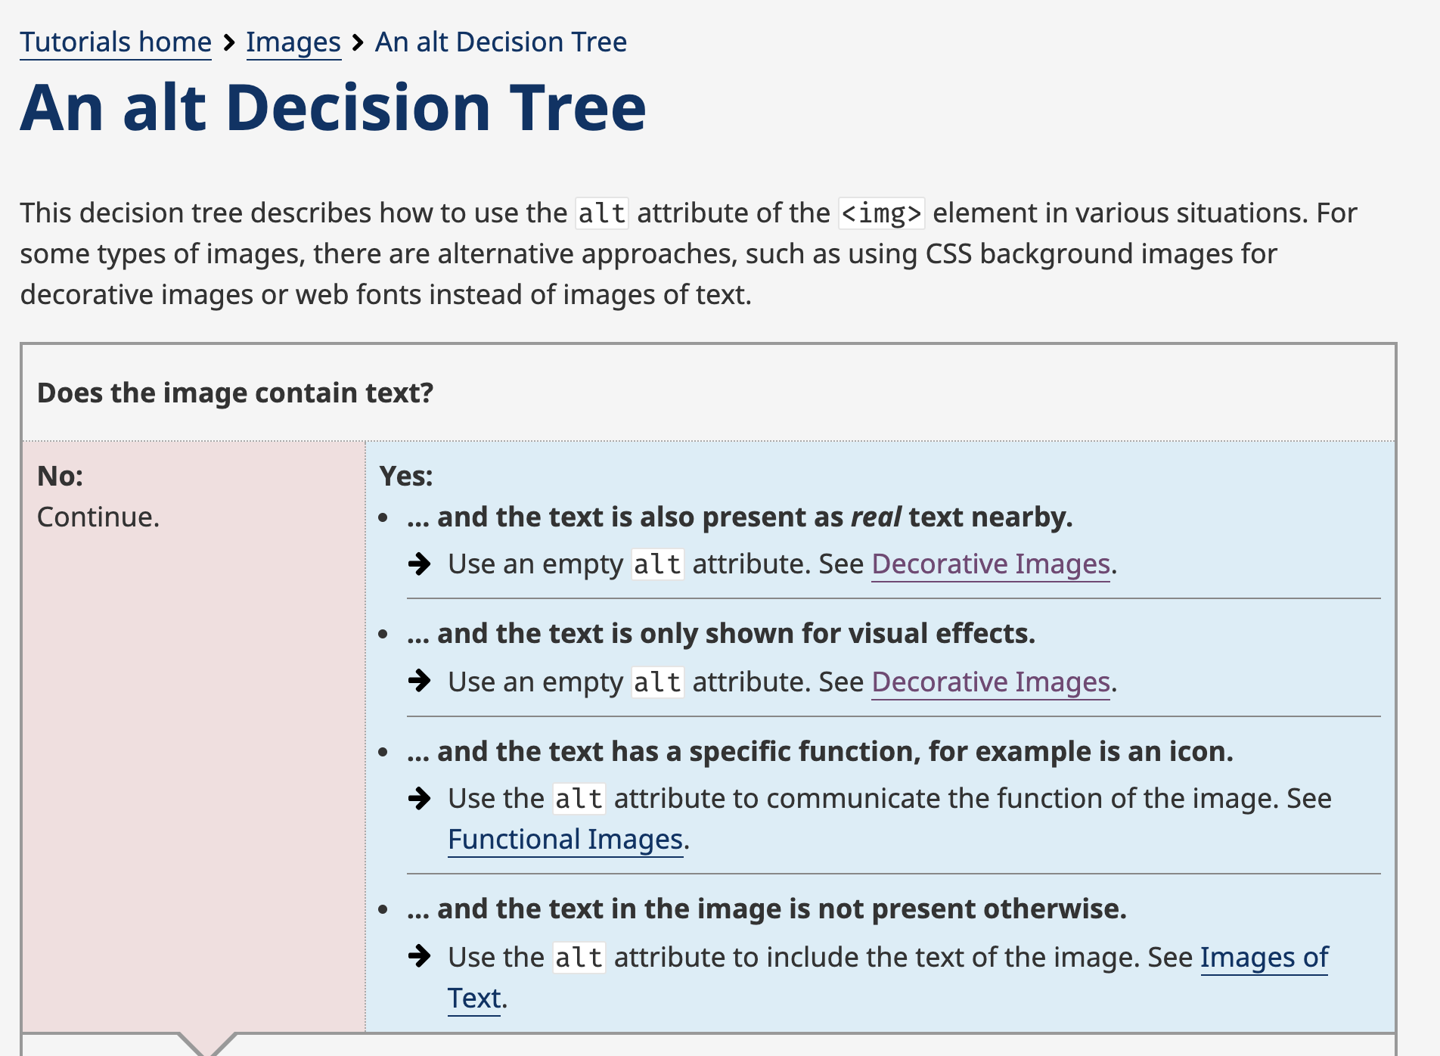
Alt decision tree

Slide 23
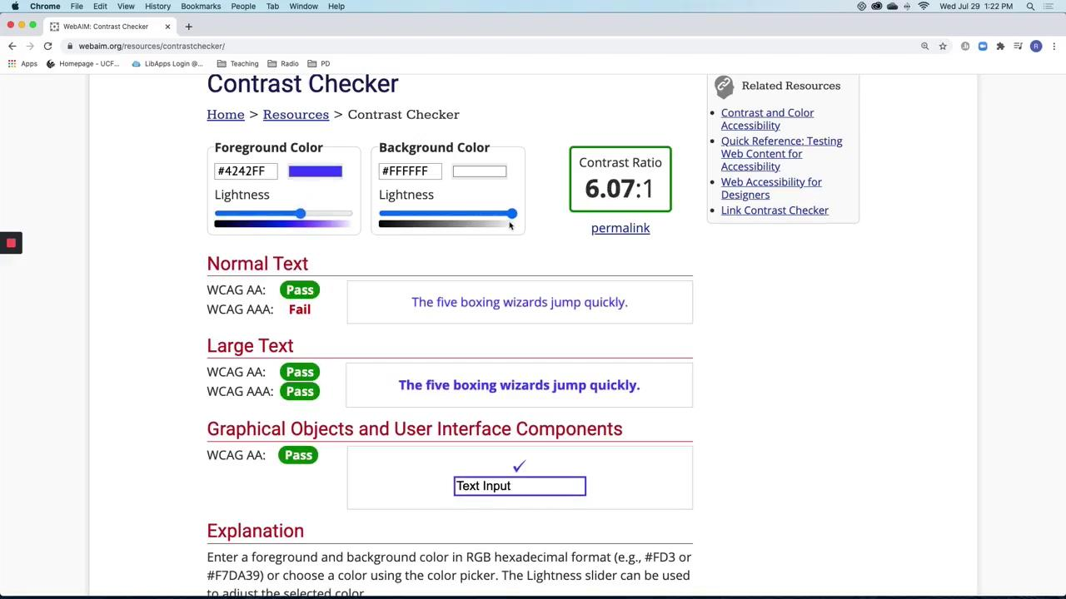
Contrast checker

Slide 24
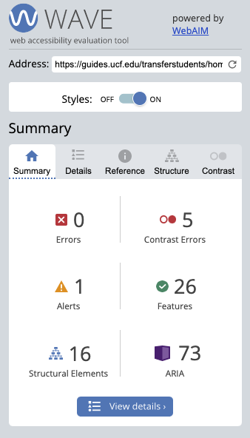
WAVE tool

Slide 25
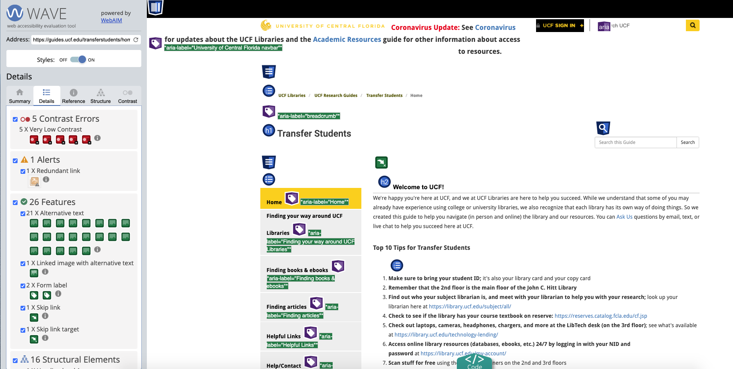
Detail of WAVE tool results

Slide 26
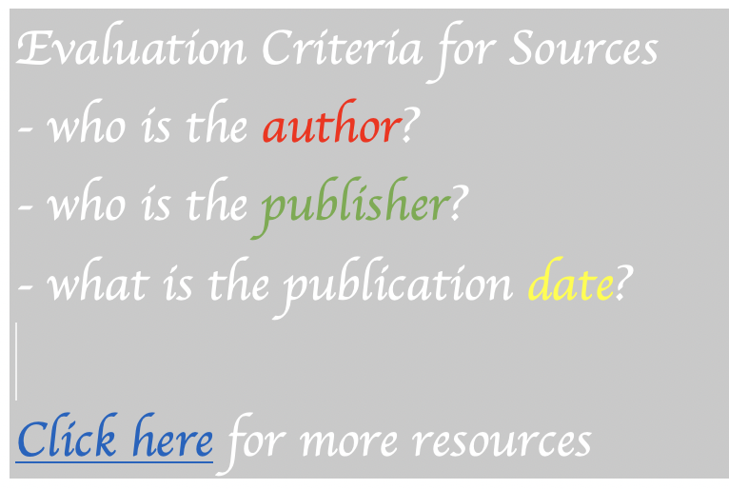
Chat Response
Examine the following example. In the chat box, type what accessibility issues you see in the examples.

Slide 27
Best Practices for Creating Accessible Videos
Include captions & transcript
Avoid auto-playing media
Use an accessible media player

Slide 28
More Tools
Transcription
Otter.ai
oTranscribe
Zoom (Option for transcript file in Cloud Recording settings)
Captioning
Amara
YouTube
Google Slides captions

Slide 29
References
CDC Disability & Health: https://www.cdc.gov/ncbddd/disabilityandhealth/disability.html
WHO Disability Dimensions: https://www.who.int/classifications/icf/en/
NCES Fast Facts Students with Disabilities: https://nces.ed.gov/fastfacts/display.asp?id=60#:~:text=How%20many%20students%20in%20postsecondary,20%20percent%20for%20female%20students.
Section 504 of Rehabilitation Act of 1973: https://www.dol.gov/agencies/oasam/centers-offices/civil-rights-center/statutes/section-504-rehabilitation-act-of-1973

Slide 30
References (continued)
Section 508 of Rehabilitation Act of 1973: https://www.section508.gov/manage/laws-and-policies
Title II of ADA: https://www.ada.gov/regs2010/titleII_2010/titleII_2010_regulations.htm
WCAG 2.1: https://www.w3.org/TR/WCAG21/
UDL Guidelines: http://udlguidelines.cast.org/
Images: Pixabay.com
Icons: thenounproject.com
All recordings created in Loom.com

Slide 31
Q & A

Slide 32
Thank you
Thank you!
Rachel Edford
rachel.edford@ucf.edu

